Slide 1
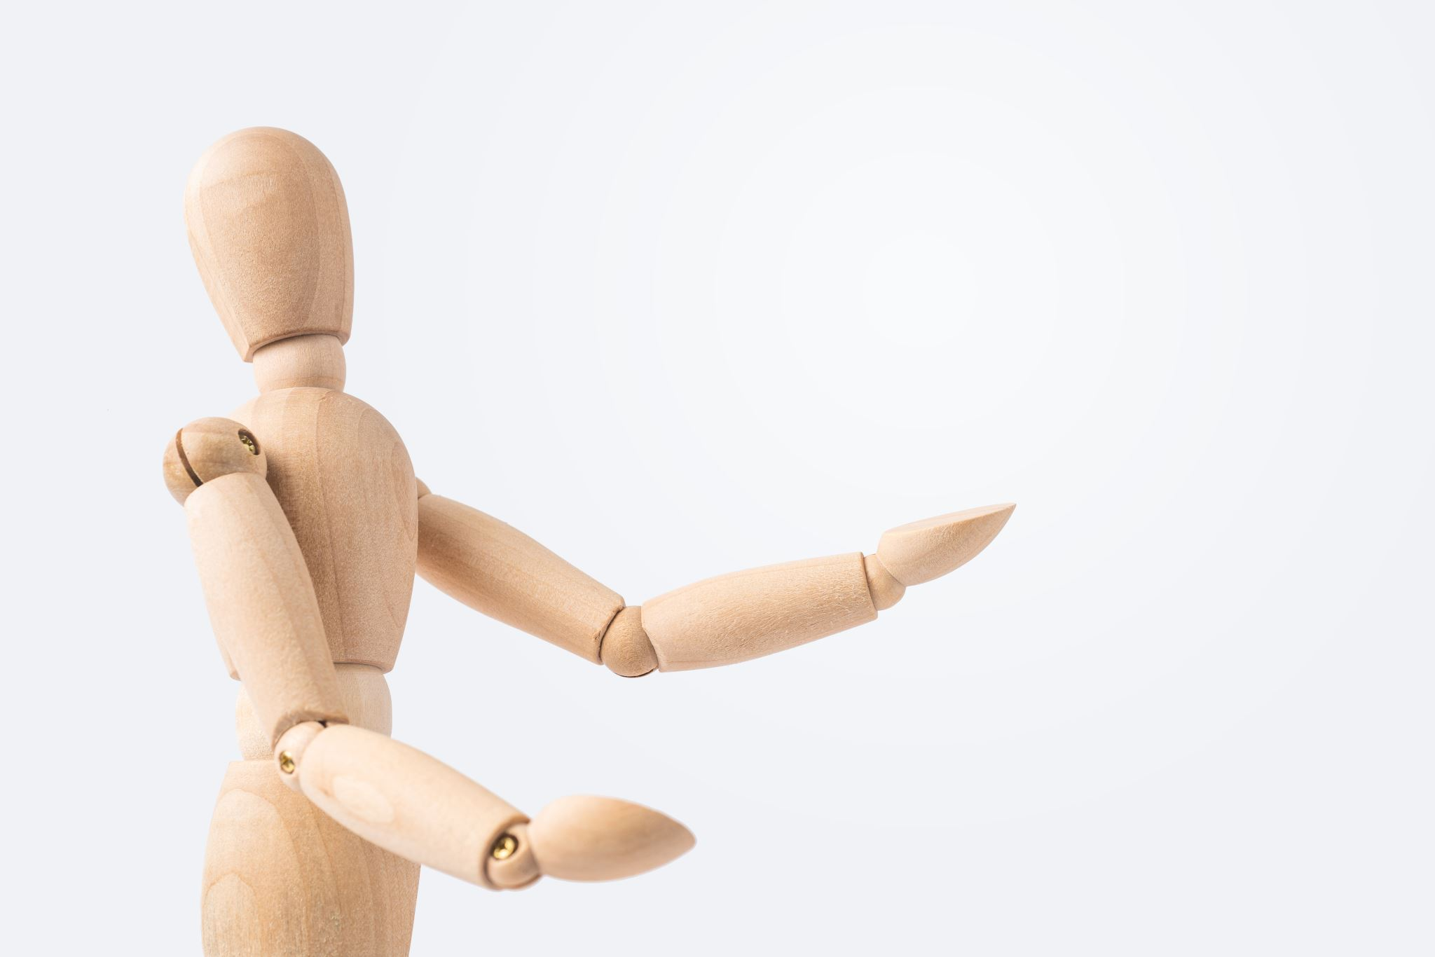
Human Pose Estimation
Guna Jaswanth Reddy Maduri
Mahesh Manchala
Phanideepak Gaddam
Prudhvi Karthik Dhanekula

Slide 2
Introduction
Title: “Human Pose Estimation: Leveraging MediaPipe and PyTorch"
Purpose: This presentation delves into the utilization of advanced technologies for precise human pose estimation.
Technologies Used: Highlighting the integration of MediaPipe for landmark detection and PyTorch for deep learning implementation.
Project Aim: Aiming to achieve accurate pose estimation from images, enhancing both the understanding and application of this technology.
Presentation Outline: An overview of the journey from dataset analysis to model training, evaluation, and potential future developments.

Slide 3
Dataset Overview
Dataset Origins: Discussing the source and characteristics of our pose estimation dataset.
Volume of Data: Utilizing a substantial dataset comprising 5081 images, ensuring diversity and comprehensiveness.
Annotations Explained: Each image is meticulously annotated with landmarks, providing a rich dataset for training.
Data Diversity: Emphasizing the variety in image conditions and poses to ensure robust model training.
Image Details: Outlining the standard resolution and format of images used in the dataset.

Slide 4
Data Processing
Preprocessing Techniques: Implementing resizing and normalization to standardize image inputs for the model.
Enhancing Data with Augmentation: Employing random flips and rotations to enrich the dataset, aiding in building a more resilient model.
Strategic Dataset Division: Carefully splitting the data into training , validation , and testing sets.
Preparing Landmarks: Transforming landmark data into tensor format for efficient processing.
Batch Processing for Efficiency: Utilizing DataLoader for effective and efficient handling of data in batches during training.

Slide 5
Network Architecture
Model Introduction: Introducing SimpleCNN, a tailored convolutional neural network for pose estimation.
Architectural Insights: Detailing the layers and structure that make up the SimpleCNN.
Handling Inputs: The model processes resized and normalized images.
Predictive Outputs: The model's capability to accurately predict coordinates of pose landmarks.
CNN's Role: The convolutional neural network's function in feature extraction and landmark prediction.

Slide 6
Training Process
Training Parameters: Discussing the setup of 5 training epochs, a batch size of 269, and an initial learning rate of 0.001.
Optimization Strategy: We have created an Adam optimizer , Which is then used to optimize the parameters of the model.
Loss Function Importance: Employing Mean Squared Error to accurately measure the model's prediction accuracy.
Optimization via Backpropagation: Detailing the process of updating model weights based on gradient descent.
Monitoring Loss Trends: Observing the decrease in loss values across training epochs, indicating model learning and improvement.

Slide 7
Experimentation and Results
Fine-Tuning Model Parameters: Exploring various hyperparameters to optimize model performance.
Observations During Training: Noting key trends and behaviors of the model throughout the training process.
Loss Reduction Trajectory: Highlighting the significant reduction in loss from 35363.6817 to 22153.9023, demonstrating model effectiveness.
Evaluation Metrics: Focusing on Mean Squared Error as the primary metric for evaluating the model's accuracy.

Slide 8
Model Evaluation
Criteria for Evaluation: Emphasizing the focus on average test loss as a measure of model performance.
Achieved Test Results: Reporting an average test loss of 0.0015, indicating high model accuracy.
Assessing Model Consistency: Discussing the reliability and stability of the model across various test scenarios.
Testing Limitations: Acknowledging any constraints encountered during the model testing phase.
Insights from Testing: Analyzing the performance and identifying areas for potential improvement.

Slide 9
Challenges and Solutions
Data Quality Management: Addressing variations in image quality and their impact on model training.
Balancing Model Complexity: Finding the optimal balance between model complexity and practical performance.
Preventing Overfitting: Implementing strategies to ensure the model generalizes well to new data.
Annotation Accuracy: Ensuring high precision in landmark annotations for effective training.
Resource Optimization: Managing computational resources efficiently throughout model development.

Slide 10

Thank you

